Slide 1
Multimedia Computing
By
Minhaz Uddin Ahmed, PhD
Department of Computer Engineering
Inha University Tashkent.
Email: minhaz.ahmed@gmail.com

Slide 2
Content
Sound
Analog-to-Digital Conversion
2.1 Sampling
2.2 Quantization
2.3 Bit Rat
Signals and Systems
3.1 Linear Time Invariant Systems
3.2 Fundamental Results in Linear Time Invariant Systems
3.3 Useful Signals
3.4 The Fourier Transform
Sampling Theorem and Aliasing
4.1 Aliasing in Spatial Domains
4.2 Aliasing in the Temporal Domain

Slide 3

What is sound ?
Sound is a wave phenomenon like light, but it is macroscopic and involves molecules of air being compressed and expanded under the action of some physical device.
For example, a speaker in an audio system vibrates back and forth and produces a longitudinal pressure wave that we perceive as sound
Without air there is no sound— example: in space

Slide 4
What is sound ?
Since sound is a pressure wave, it takes on continuous values, as opposed to digitized ones with a finite range.
Although such pressure waves are longitudinal, they still have ordinary wave properties and behaviors, such as reflection (bouncing), refraction (change of angle when entering a medium with a different density), and diffraction (bending around an obstacle). This makes the design of “surround sound” possible.
Since sound consists of measurable pressures at any 3D point, we can detect it by measuring the pressure level at a location, using a transducer to convert pressure to voltage levels

Slide 5
Digital data acquisition
Multimedia systems involve three major components:
a) Multimedia content creation
b) Compression/storage of multimedia content, and
c) Delivery or distribution of multimedia content

Slide 6
Digital data acquisition
Creating multimedia content using text, audio, video, and images is
to record these individual media types into a digital form, making it is easy to combine and assemble these heterogeneous entities.
Digitizing one-dimensional (such as audio)
Two-dimensional (such as images)
Three-dimensional (such as video)
Notes:
Sound Since there is only one independent variable, time, we call this a 1D signal

Slide 7
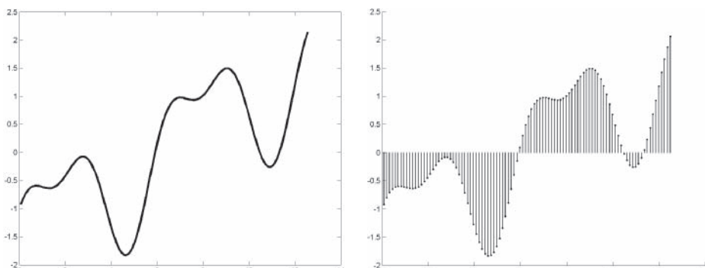
ANALOG AND DIGITAL SIGNALS
A signal is analog if it can be represented by a continuous function. For instance, it might encode the changing amplitude with respect to an input dimension(s).
Digital signals, on the other hand, are represented by a discrete set of values defined at specific (and most often regular) instances of the input domain, which might be time, space, or both
Figure 2-1 Example of an analog signal (left) and a digital signal (right) in one dimension
Notes:
Analog signals are captured by a recording device, which attempts to record a physical signal.

Slide 8
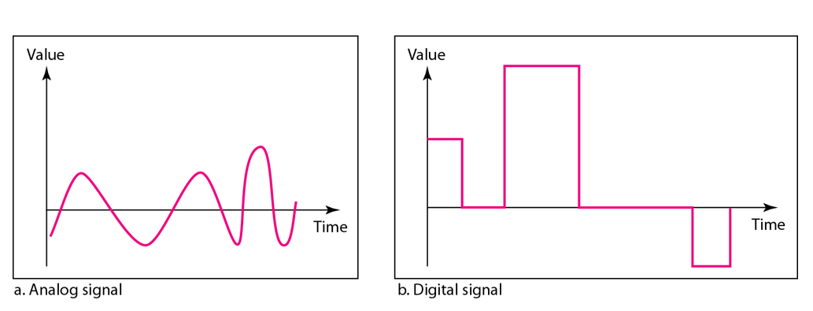
ANALOG AND DIGITAL SIGNALS

Slide 9
Advantages of digital signals over analog
When media is represented digitally, it is possible to create complex, interactive content. it is easy to access a pixel in an image, or a group of pixels in a region or even a section of a sound track. Different digital operations can be applied to each, such as to enhance the image quality of a region, or to remove noise in a sound track.
Stored digital signals do not degrade over time or distance as analog signals do. One of the most common artifacts of broadcast VHS video is ghosting, as stored VHS tapes lose their image quality by repeated usage and degradation of the medium over time.

Slide 10
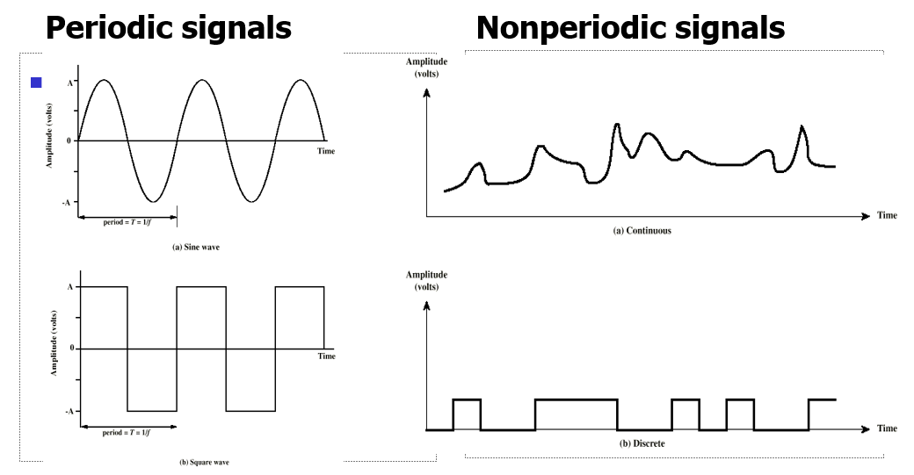
ANALOG AND DIGITAL SIGNALS
Periodic analog signals can be classified as simple or composite. A simple periodic analog signal, a sine wave, cannot be decomposed into simpler signals. A composite periodic analog signal is composed of multiple sine waves.

Slide 11
Advantages of digital signals over analog
Digital data can be efficiently compressed and transmitted across digital networks. This includes active and live distribution models, such as digital cable, video on demand, and passive distribution schemes, such as video on a DVD.
It is easy to store digital data on magnetic media such as hard drives, or solid state memory devices, such as flash drives, memory cards. This is because the representation of digital data, whether audio, image, or video, is a set of binary values, regardless of data type.
Digital data is preferred because it offers better quality and higher fidelity, compressed, distributed, stored, and retrieved relatively easily.

Slide 12
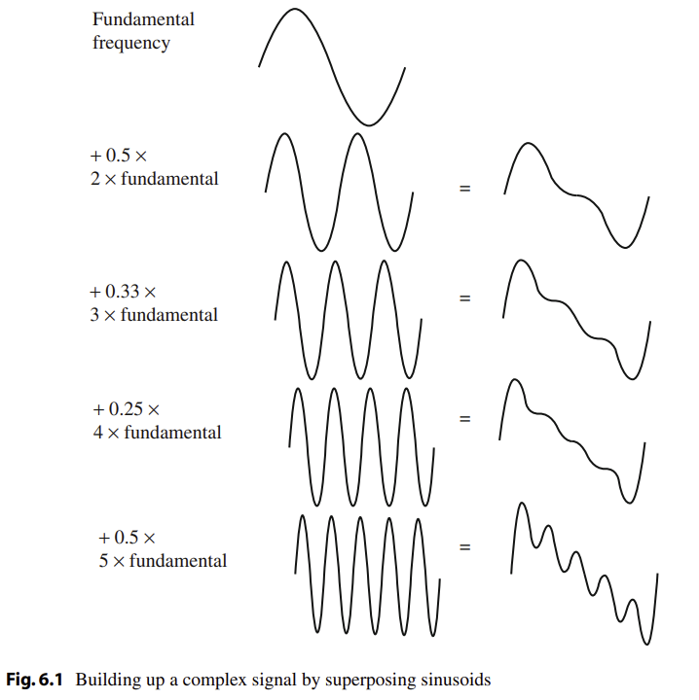
Building complex signal
sampling—using measurements only at evenly spaced time intervals—is simply called sampling, and the rate at which it is performed is called the sampling frequency

Slide 13
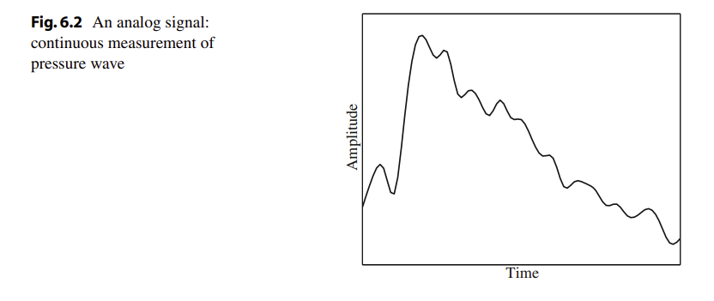
Digitization process
For audio, typical sampling rates are from 8 kHz (8,000 samples per second) to 48 kHz. The human ear can hear from about 20 Hz (a very deep rumble) to as much as 20 kHz; above this level, we enter the range of ultrasound. The human voice can reach approximately 4 kHz

Slide 14
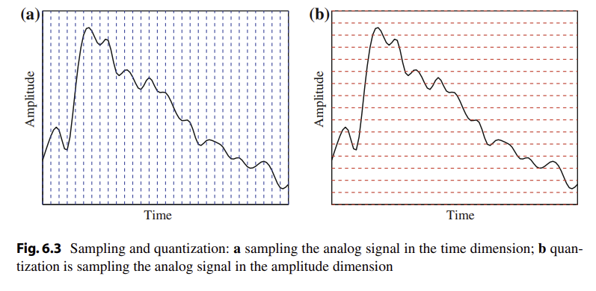
Sampling vs Quantization

Slide 15
ANALOG-TO-DIGITAL CONVERSION
The conversion of signals from analog to digital occurs via two main processes: sampling and quantization.
The reverse process of converting digital signals to analog is known as interpolation.
One of the most desirable properties in the analog to digital conversion is to ensure that no artifacts are created in the digital data. That way, when the signal is converted back to the analog domain, it will look the same as the original analog signal.

Slide 16
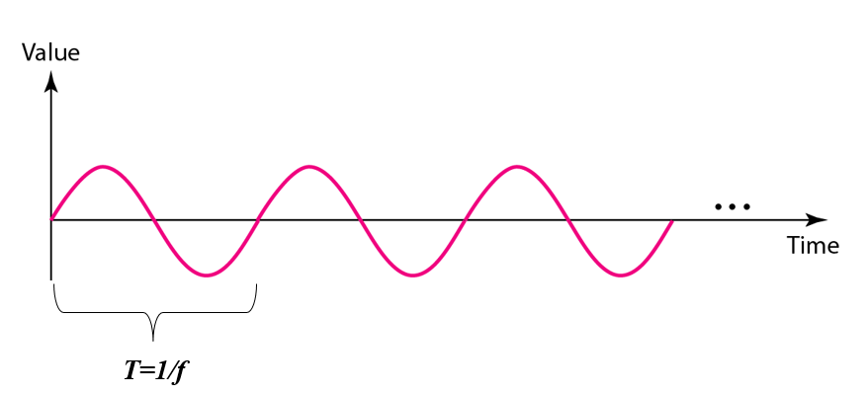
ANALOG-TO-DIGITAL CONVERSION
Peak amplitude (A)
  maximum strength of signal
  volts
Frequency (f)
  rate of change of signal
  Hertz (Hz) or cycles per second
  period = time for one repetition (T)
  T = 1/f
Phase (φ)
  relative position in time
Figure: A sine wave

Slide 17
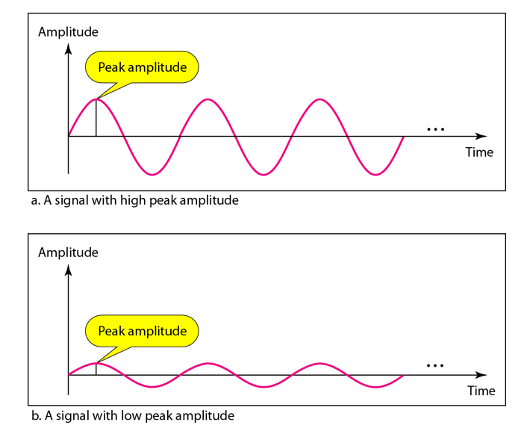
ANALOG-TO-DIGITAL CONVERSION
Figure: Two signals with the same phase and frequency, but different amplitudes

Slide 18
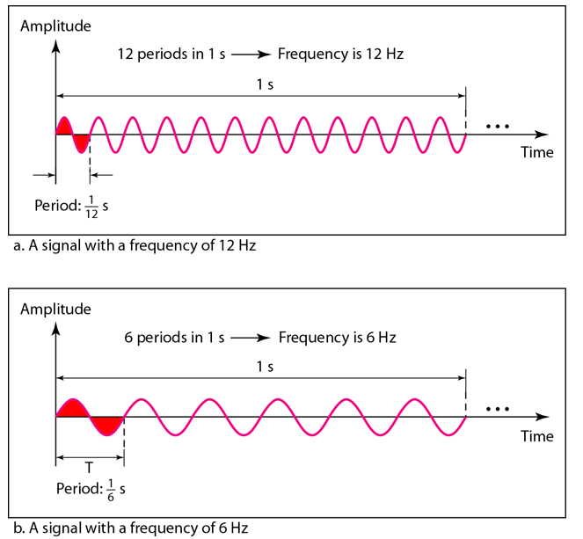
ANALOG-TO-DIGITAL CONVERSION
Figure: Two signals with the
same amplitude and phase,
but different frequencies

Slide 19

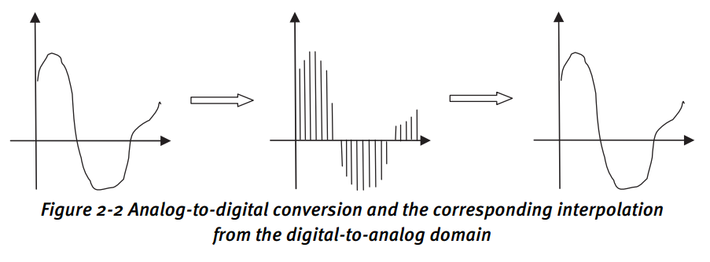
ANALOG-TO-DIGITAL CONVERSION
Sampling
Assume that we start with a one-dimensional analog signal in the time t domain, with an amplitude given by x(t). The sampled signal is given by
Notes:
Hence, xs(1)= x(T); xs(2) =x(2T); xs(3) =x(3T); and so on. If you reduce T (increase f), the number of samples increases; and correspondingly, so does the storage requirement.
Vice versa, if T increases (f decreases), the number of samples collected for the signal decrease and so does the storage requirement. T is clearly a critical parameter.

Slide 20
ANALOG-TO-DIGITAL CONVERSION
For commonly used signals, sampling is done across one dimension (time, for sound signals), two dimensions (spatial x and y, for images), or three dimensions (x, y, time for video, or x, y, z for sampling three-dimensional ranges).
Practical sampling involves averaging, either in time or space.
Notes:
It is important to note that the sampling scheme described here is theoretical.

Slide 21

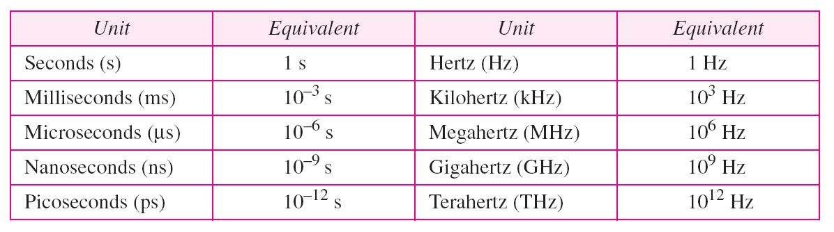
ANALOG-TO-DIGITAL CONVERSION
Frequency and period are the inverse of each other.
Units of period and frequency

Slide 22
ANALOG-TO-DIGITAL CONVERSION
Frequency is the rate of change with respect to time.
Change in a short span of time means high frequency
Change over a long span of time means low frequency.

Slide 23
ANALOG-TO-DIGITAL CONVERSION
If a signal does not change at all, its frequency is zero.
If a signal changes instantaneously, its frequency is infinite.
Phase describes the position of the waveform relative to time 0

Slide 24
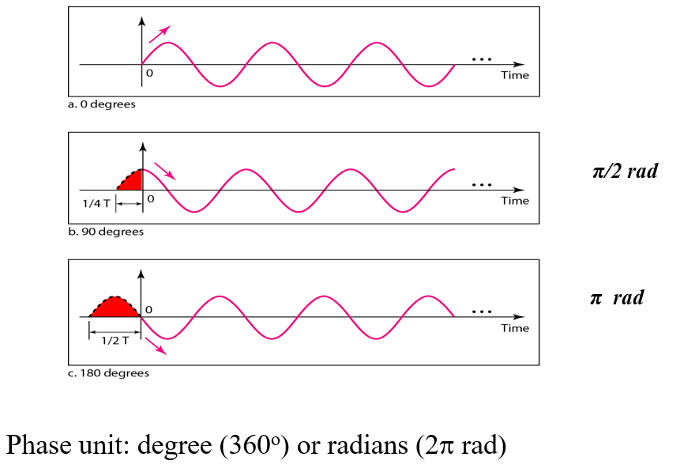
ANALOG-TO-DIGITAL CONVERSION
Figure: Three sine waves with the same amplitude and frequency, but different phases

Slide 25
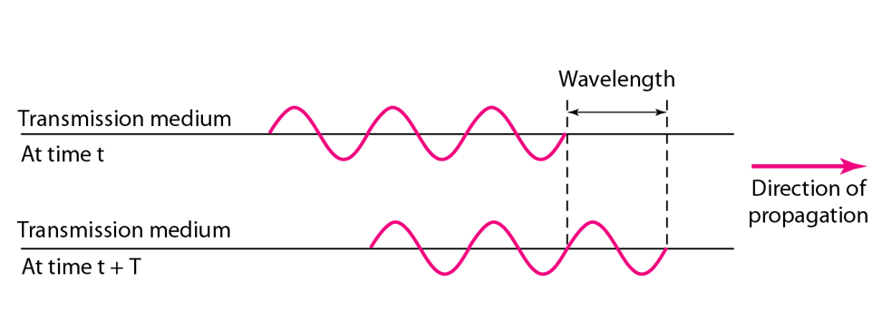
ANALOG-TO-DIGITAL CONVERSION
Figure: Wavelength and period

Slide 26
ANALOG-TO-DIGITAL CONVERSION
Wavelength (λ) is distance occupied by one cycle
  Another word, distance is a simple signal travels in one period.
between two points of corresponding phase in two consecutive cycles
assuming signal velocity v have λ = vT
λ standard unit: meter (m)

Slide 27
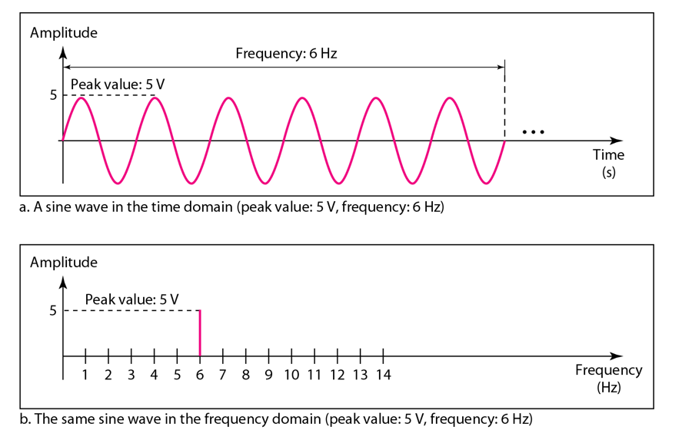
ANALOG-TO-DIGITAL CONVERSION
Figure: The time-domain and frequency-domain plots of a sine wave

Slide 28
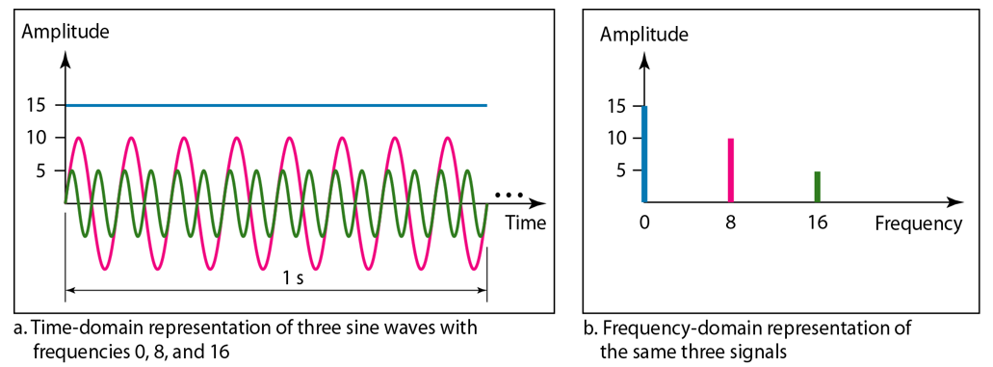
ANALOG-TO-DIGITAL CONVERSION
A complete sine wave in the time domain can be represented by one single spike in the frequency domain.
The frequency domain is more compact and useful when we are dealing with more than one sine wave. Figure shows three sine waves, each with different amplitude and frequency. All can be represented by three spikes in the frequency domain.

Slide 29
ANALOG-TO-DIGITAL CONVERSION
2.2 Quantization
Quantization deals with encoding the signal value at every sampled location with a predefined precision, defined by a number of levels.
The entire range R of the signal is represented by a finite number of bits b. Formally,
having a quantization step delta

Slide 30
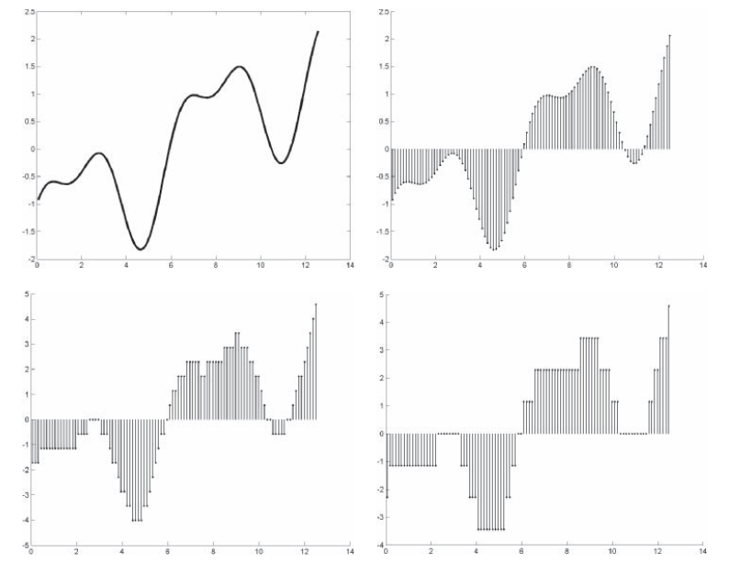
ANALOG-TO-DIGITAL CONVERSION
2.2 Quantization
Figure 2-3 Original analog signal (upper left) is shown sampled and quantized at different quantization levels. For quantization, 8 bits (256 levels), 4 bits (16 levels), and 3 bits (8 levels) were used to produce the digital signals on the top right, bottom left, and bottom right, respectively.

Slide 31
ANALOG-TO-DIGITAL CONVERSION
Figure 2-3 shows an analog signal, which is sampled at a common frequency, but quantized using different number of bits, 4 or 2.
Because each sample is represented by a finite number of bits, the quantized value will differ from the actual signal value, thus always introducing an error.
The question, then, is how many bits should be used to represent each sample? Is this number the same for all signals?
This actually depends on the type of signal and what its intended use is. Audio signals, which represent music, must be quantized on 16 bits, whereas speech only requires 8 bits.
the output range of the signal is divided into fixed and uniformly separated intervals depending on the number of bits used. This works well when all the values in the range of the signal are equally likely and, thus, the quantization error is equally distributed

Slide 32
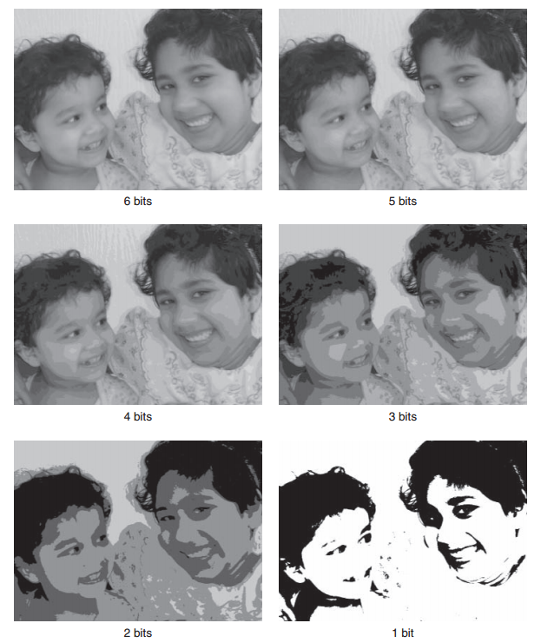
ANALOG-TO-DIGITAL CONVERSION
Figure 2-4 Examples of quantization; initial image had 8 bits per pixel, which is shown quantized from 6 bits down to 1 bit per pixel

Slide 33
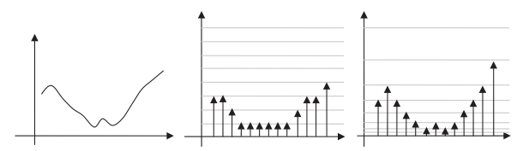
ANALOG-TO-DIGITAL CONVERSION
Figure 2-5 Nonlinear quantization scales. The left signal shows the original analog signal.
The corresponding digitized signal using linear quantization is shown in the center.
The right signal is obtained by a logarithmically quantized interval scale.

Slide 34
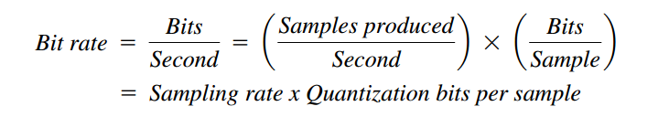
ANALOG-TO-DIGITAL CONVERSION
2.3 Bit Rate
The number of bits being produced per second. Bit rate is of critical importance when it comes to storing a digital signal, or transmitting it across networks, which might have high, low, or even varying bandwidths. Bit rate, which is measured in terms of bits per second, consists of the following:

Slide 35
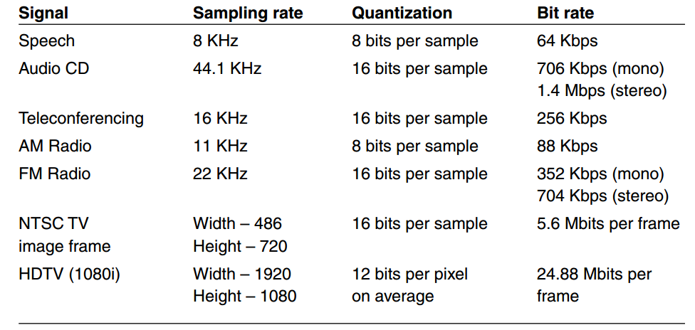
ANALOG-TO-DIGITAL CONVERSION
Figure 2-6 Table giving the sampling rate, quantization factor, and bit rates produced for typical signals
Notes:
Ideally, the bit rate should be just right to capture or convey the necessary information with minimal perceptual distortion, while also minimizing storage requirements

Slide 36
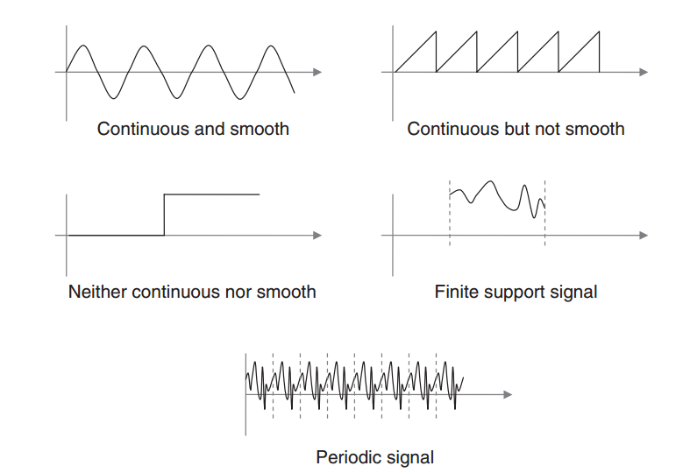
SIGNALS AND SYSTEMS
Figure 2-7 Sample signals with different kinds of properties—smooth, unsmooth, continuous, discontinuous, finite support, and periodic. Normally, signals are composed of a combination of one or more of these properties.

Slide 37
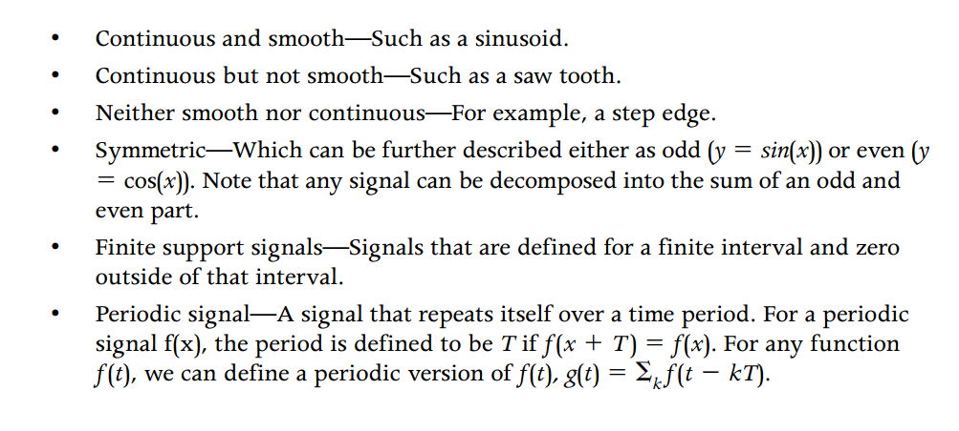
SIGNALS AND SYSTEMS

Slide 38
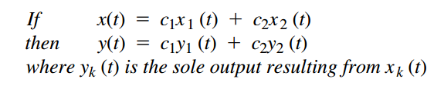
Linear Time Invariant Systems
Any operation that transforms a signal is called a system. Understanding linear time invariant systems is necessary to gain insight into the fundamental results that now characterize the process by which any practical system performs sampling and digitization.
Let a system transform an input signal x(t) into an output y(t). We call this system a linear if the output and input obey the following:

Slide 39
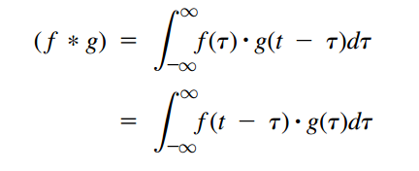
Linear Time Invariant Systems
Another important operation that is used to process signals in an LTI system is convolution. The convolution of two signals f and g is mathematically represented by f*g. It is the result of taking the integral of the first signal multiplied with the other signal reversed and shifted.

Slide 40
Linear Time Invariant Systems
Any LTI system is fully characterized by a specific function, which is called the impulse response of the system. The output of the system is the convolution of the input with the system’s impulse response. This analysis is termed as the time Domain point of view of the system.
Alternatively, we can also express this result in the frequency domain by defining the system’s transfer function. The transfer function is the Fourier transform of the system’s impulse response

Slide 41
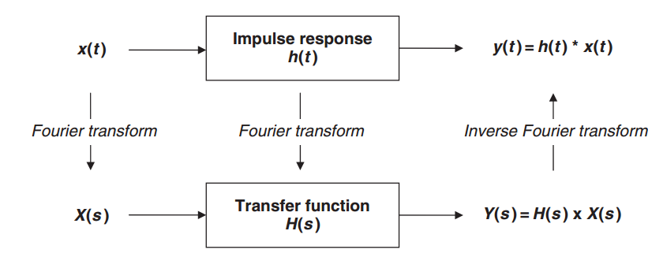
Linear Time Invariant Systems
Figure 2-8 Relationship between the impulse response function in the time
domain and the transfer function in the frequency domain

Slide 42

3.3 Useful Signals
Specific signals—for example, the Delta function, box function, step function—play an important role in many signaling-processing operations, such as sampling, filtering, and convolution
The Delta function is a mathematical construct introduced by the theoretical physicist Paul Dirac and, hence, is also known as the Dirac Delta function. Informally, it is a sharp peak bounding a unit area: (x) is zero everywhere except at x =0 where it becomes infinite, and its integral is 1

Slide 43
The Fourier Transform
The Fourier transform is due to Joseph Fourier (1768–1830), who published his initial results in 1807. Fourier proposed to represent any periodic, continuous signal as a sum of individual complex sinusoids (a Fourier series expansion).
In other words every periodic, continuous signal can be expressed as a weighted combination of sinusoid (sine and cosine) waves. The weights that are used to combine the sinusoids are called the Fourier series coefficients, or spectral components.

Slide 44
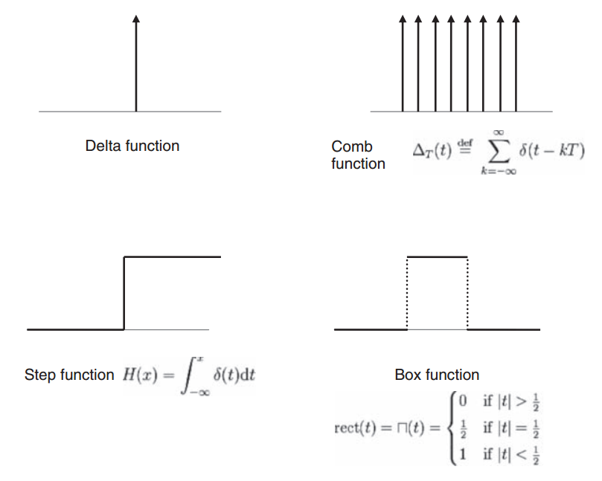
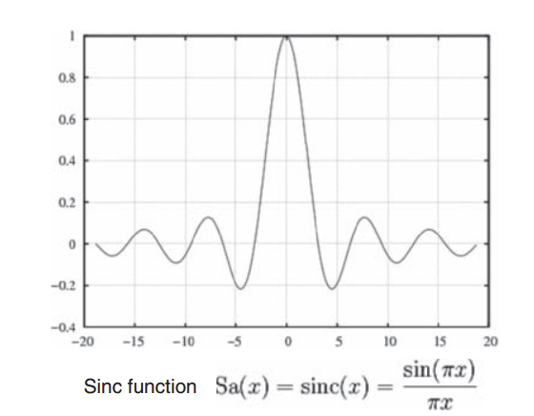
The Fourier Transform
Figure 2-9 Useful functions in signal-processing theory: Delta function (top left), comb function (top right), step function (middle left), box function (middle right), and sinc function (right)

Slide 45
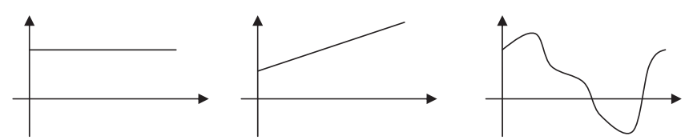
Some sample signals
Figure 2-10 Examples of simple one-dimensional functions. Different numbers of samples are required to digitize them
Some sample signals are shown in Figure 2-10

Slide 46
SAMPLING THEOREM AND ALIASING
If these signals are to be digitized and reproduced back in the analog domain, the number of samples required to ensure that both starting and ending analog signals are the same is clearly different. For instance, in the first case where the signal is not changing (and, hence, has zero frequency), one single sample will suffice for this purpose.
Two samples are required for the second signal and many more for the third one. As we go from left to right, the frequency content in the signals increases, and, therefore, the number of samples needed during the digitization process also goes up

Slide 47
SAMPLING THEOREM AND ALIASING
The relationship between signals and sampling rate was established during the late 1920s by Henry Nyquist and later formalized by Claude Shannon in 1950.
This relationship states that the signal has to be sampled using a sampling frequency that is greater than twice the maximal frequency occurring in the signal

Slide 48
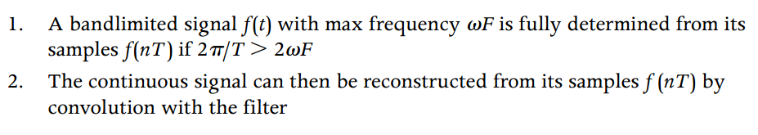

SAMPLING THEOREM AND ALIASING
it can more formally be stated as follows:
For example, if the signal has a maximal frequency of 10 kHz, it should be sampled at a frequency greater than 20 kHz. Here, 20 kHz is known as the Nyquist sampling frequency for that signal.

Slide 49
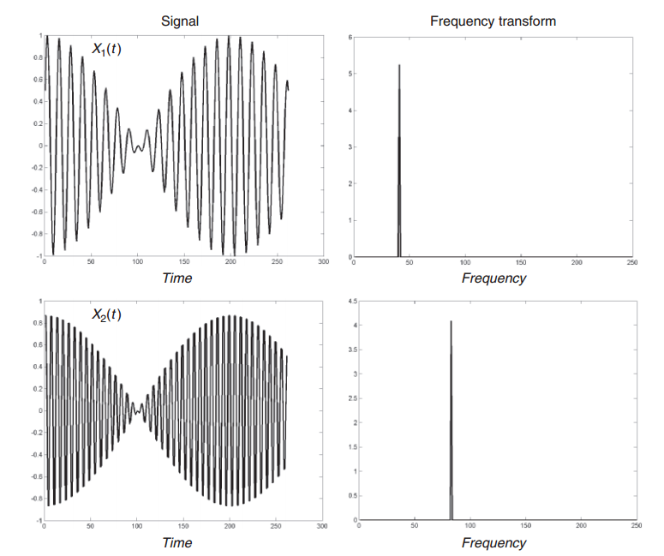
SAMPLING THEOREM AND ALIASING
Figure 2-11 Two signals x 1 (t) and x2 (t) having different frequencies are shown on the left and their Fourier transforms on the right. The transforms show the amount of energy at all frequencies. Both input signals have just one frequency as their Fourier transform shows, but the frequency in x1 (t) is lower than that in x2(t)

Slide 50
SAMPLING THEOREM AND ALIASING
What happens if your sampling frequency is higher than your Nyquist frequency? The answer is: nothing special.
When it comes to reproducing your analog signal, it is guaranteed to have all the necessary frequencies and, hence, the same signal is reproduced.
However, by performing such over sampling, you have generated more digital data than necessary, which increases your storage and transmission overhead.

Slide 51
SAMPLING THEOREM AND ALIASING
What happens if your sampling frequency is lower than your Nyquist frequency?
In this case, you have a problem because all the frequency content is not well captured during the digitization process. As a result, when the digital signal is heard/viewed or converted back into analog form, it does not correspond to the initial starting analog signal.
Aliasing is the term used to describe loss of information during digitization

Slide 52
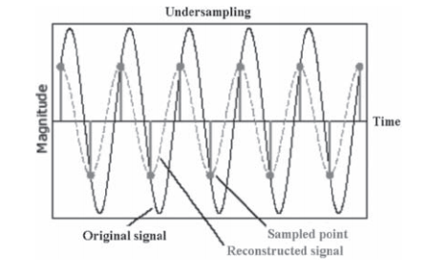
SAMPLING THEOREM AND ALIASING
Aliasing in Spatial Domains
Aliasing effects in the spatial domain are seen in all dimensions. Figure 2-12 illustrates examples in one and two dimensions.

Slide 53
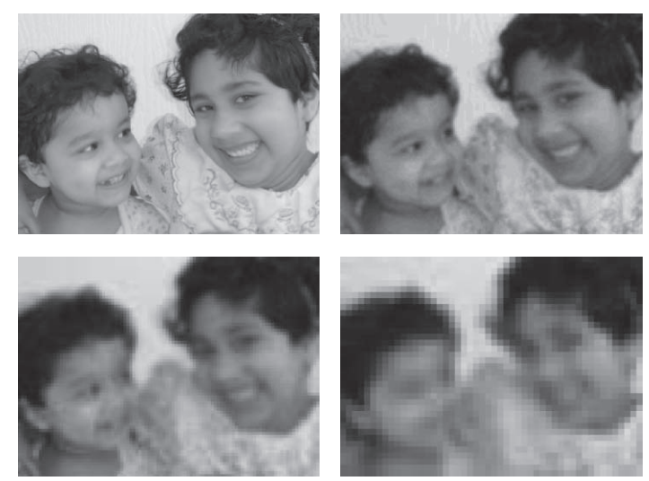
SAMPLING THEOREM AND ALIASING
Figure 2-12 Aliasing examples in the spatial domain. The top figure shows an example in one dimension, where original signal is shown along with sampled points and the reconstructed signal. The bottom set of figures show a 2D input image signal. The top left shows the original signal and the remaining three show examples of the signal reconstruction at different sampling resolutions.

Slide 54
SAMPLING THEOREM AND ALIASING
In the two-dimensional example, the first image shows the original image consists of 750 samples in the x and 620 samples in the y direction. The succeeding figures show what the reconstructed signal looks like by reducing the sampling resolution in both directions.
You can see that, as the number of spatial samples decreases, not all of the original frequencies are properly captured.

Slide 55
SAMPLING THEOREM AND ALIASING
Aliasing in the Temporal Domain
Examples of temporal aliasing can be seen in western movies, by observing the motion of stagecoach wheels. As the stagecoach starts to move, we observe its wheels rotating in the expected forward direction. As the stagecoach speeds up, we see that the wheels appear to rotate in the opposite direction to the initial one.
This occurs because the movie camera has under sampled the wheels’ motion
Notes:
https://www.youtube.com/watch?v=B8EMI3_0TO0
https://www.youtube.com/watch?v=Ddxf2YESIgw

Slide 56
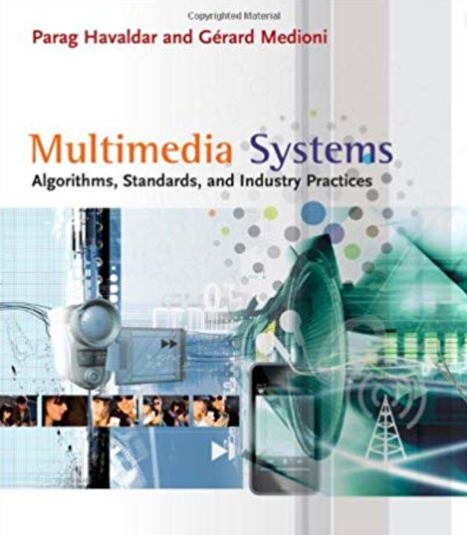
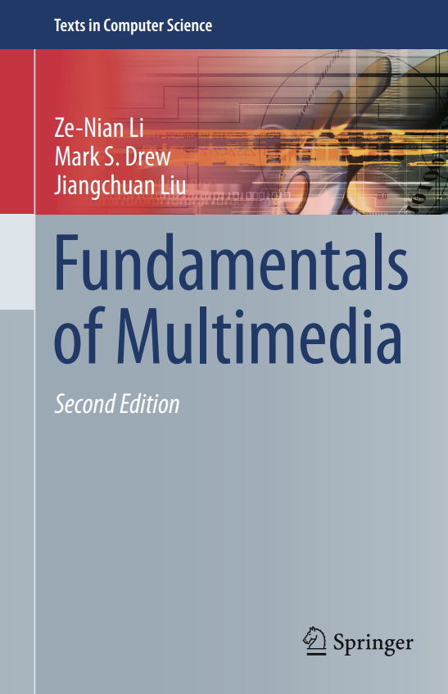
Reference

Slide 57

Question

Slide 58

Thank you

